Slide 1
Cart Example

Slide 2
The data
Day | Outlook | Temp. | Humidity | Wind | Decision
1 | Sunny | Hot | High | Weak | No
2 | Sunny | Hot | High | Strong | No
3 | Overcast | Hot | High | Weak | Yes
4 | Rain | Mild | High | Weak | Yes
5 | Rain | Cool | Normal | Weak | Yes
6 | Rain | Cool | Normal | Strong | No
7 | Overcast | Cool | Normal | Strong | Yes
8 | Sunny | Mild | High | Weak | No
9 | Sunny | Cool | Normal | Weak | Yes
10 | Rain | Mild | Normal | Weak | Yes
11 | Sunny | Mild | Normal | Strong | Yes
12 | Overcast | Mild | High | Strong | Yes
13 | Overcast | Hot | Normal | Weak | Yes
14 | Rain | Mild | High | Strong | No

Slide 3
Gini index
Gini index is a metric for classification tasks in CART. It stores sum of squared probabilities of each class. We can formulate it as illustrated below.
Gini = 1 – Σ (Pi)² for i=1 to number of classes

Slide 4
Outlook
Gini = 1 – Σ (Pi)² for i=1 to number of classes
Outlook is a nominal feature. It can be sunny, overcast or rain. I will summarize the final decisions for outlook feature.
Gini(Outlook=Sunny) = 1 – (2/5)² – (3/5)² = 1 – 0.16 – 0.36 = 0.48
Gini(Outlook=Overcast) = 1 – (4/4)² – (0/4)² = 0
Gini(Outlook=Rain) = 1 – (3/5)² – (2/5)² = 1 – 0.36 – 0.16 = 0.48
Outlook | Yes | No | Number of instances
Sunny | 2 | 3 | 5
Overcast | 4 | 0 | 4
Rain | 3 | 2 | 5
Obtain overall impurity measure (weighted avg. of individual rectangles)
Then, we will calculate weighted sum of gini indexes for outlook feature.
Gini(Outlook) = (5/14) x 0.48 + (4/14) x 0 + (5/14) x 0.48 = 0.171 + 0 + 0.171 = 0.342

Slide 5
Temperature
Similarly, temperature is a nominal feature and it could have 3 different values: Cool, Hot and Mild. Let’s summarize decisions for temperature feature.
Gini(Temp=Hot) = 1 – (2/4)² – (2/4)² = 0.5
Gini(Temp=Cool) = 1 – (3/4)² – (1/4)² = 1 – 0.5625 – 0.0625 = 0.375
Gini(Temp=Mild) = 1 – (4/6)² – (2/6)² = 1 – 0.444 – 0.111 = 0.445
We’ll calculate weighted sum of gini index for temperature feature
Gini(Temp) = (4/14) x 0.5 + (4/14) x 0.375 + (6/14) x 0.445 = 0.142 + 0.107 + 0.190 = 0.439
Temperature | Yes | No | Number of instances
Hot | 2 | 2 | 4
Cool | 3 | 1 | 4
Mild | 4 | 2 | 6

Slide 6
Humidity/Wind
Humidity | Yes | No | Number of instances
High | 3 | 4 | 7
Normal | 6 | 1 | 7
Humidity is a binary class feature. It can be high or normal.
Gini(Humidity=High) = 1 – (3/7)² – (4/7)² = 1 – 0.183 – 0.326 = 0.489
Gini(Humidity=Normal) = 1 – (6/7)² – (1/7)² = 1 – 0.734 – 0.02 = 0.244
Weighted sum for humidity feature will be calculated next
Gini(Humidity) = (7/14) x 0.489 + (7/14) x 0.244 = 0.367
Wind | Yes | No | Number of instances
Weak | 6 | 2 | 8
Strong | 3 | 3 | 6
Wind is a binary class similar to humidity. It can be weak and strong.
Gini(Wind=Weak) = 1 – (6/8)² – (2/8)² = 1 – 0.5625 – 0.062 = 0.375
Gini(Wind=Strong) = 1 – (3/6)² – (3/6)² = 1 – 0.25 – 0.25 = 0.5
Gini(Wind) = (8/14) x 0.375 + (6/14) x 0.5 = 0.428

Slide 7
Choice
We’ve calculated gini index values for each feature. The winner will be outlook feature because its cost is the lowest.
We’ll put outlook decision at the top of the tree.
Feature | Gini index
Outlook | 0.342
Temperature | 0.439
Humidity | 0.367
Wind | 0.428

Slide 8
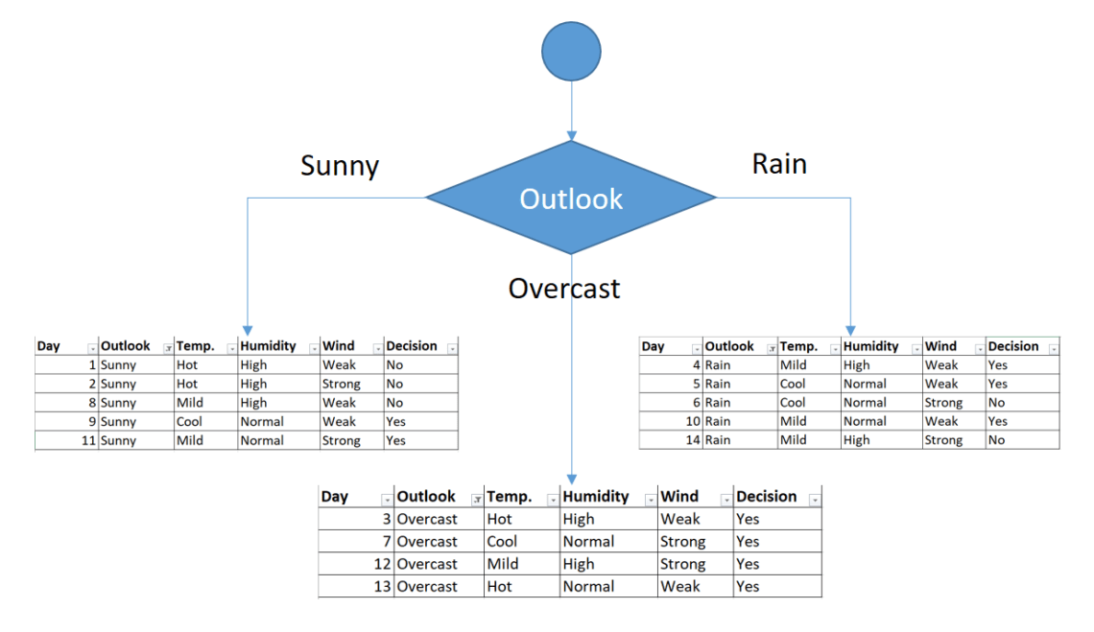
Constructing the decision tree

Slide 9
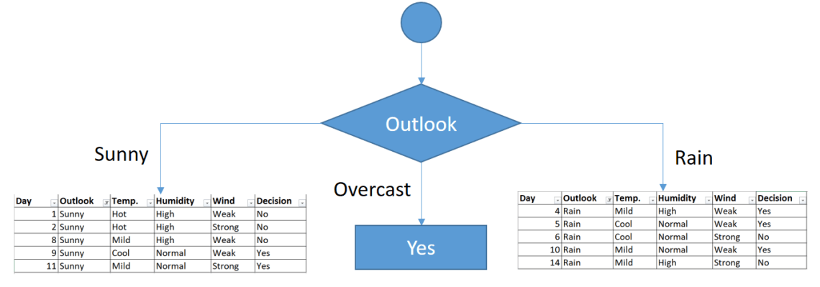
The sub dataset in the overcast leaf has only yes decisions. This means that overcast leaf is over.

Slide 10
We will apply same principles to those sub datasets in the following steps.
Focus on the sub dataset for sunny outlook. We need to find the gini index scores for temperature, humidity and wind features respectively.
Day | Outlook | Temp. | Humidity | Wind | Decision
1 | Sunny | Hot | High | Weak | No
2 | Sunny | Hot | High | Strong | No
8 | Sunny | Mild | High | Weak | No
9 | Sunny | Cool | Normal | Weak | Yes
11 | Sunny | Mild | Normal | Strong | Yes

Slide 11
Gini of temperature for sunny outlook
Gini(Outlook=Sunny and Temp.=Hot) = 1 – (0/2)² – (2/2)² = 0
Gini(Outlook=Sunny and Temp.=Cool) = 1 – (1/1)² – (0/1)² = 0
Gini(Outlook=Sunny and Temp.=Mild) = 1 – (1/2)² – (1/2)² = 1 – 0.25 – 0.25 = 0.5
Gini(Outlook=Sunny and Temp.) = (2/5)x0 + (1/5)x0 + (2/5)x0.5 = 0.2
Temperature | Yes | No | Number of instances
Hot | 0 | 2 | 2
Cool | 1 | 0 | 1
Mild | 1 | 1 | 2
Gini of humidity for sunny outlook
Gini(Outlook=Sunny and Humidity=High) = 1 – (0/3)² – (3/3)² = 0
Gini(Outlook=Sunny and Humidity=Normal) = 1 – (2/2)² – (0/2)² = 0
Gini(Outlook=Sunny and Humidity) = (3/5)x0 + (2/5)x0 = 0
Humidity | Yes | No | Number of instances
High | 0 | 3 | 3
Normal | 2 | 0 | 2

Slide 12
Gini of wind for sunny outlook
Gini(Outlook=Sunny and Wind=Weak) = 1 – (1/3)² – (2/3)² = 0.266
Gini(Outlook=Sunny and Wind=Strong) = 1- (1/2)² – (1/2)² = 0.2
Gini(Outlook=Sunny and Wind) = (3/5)x0.266 + (2/5)x0.2 = 0.466
Wind | Yes | No | Number of instances
Weak | 1 | 2 | 3
Strong | 1 | 1 | 2
Decision for sunny outlook
We’ve calculated gini index scores for feature when outlook is sunny. The winner is humidity because it has the lowest value.
We’ll put humidity check at the extension of sunny outlook.
Feature | Gini index
Temperature | 0.2
Humidity | 0
Wind | 0.466

Slide 13
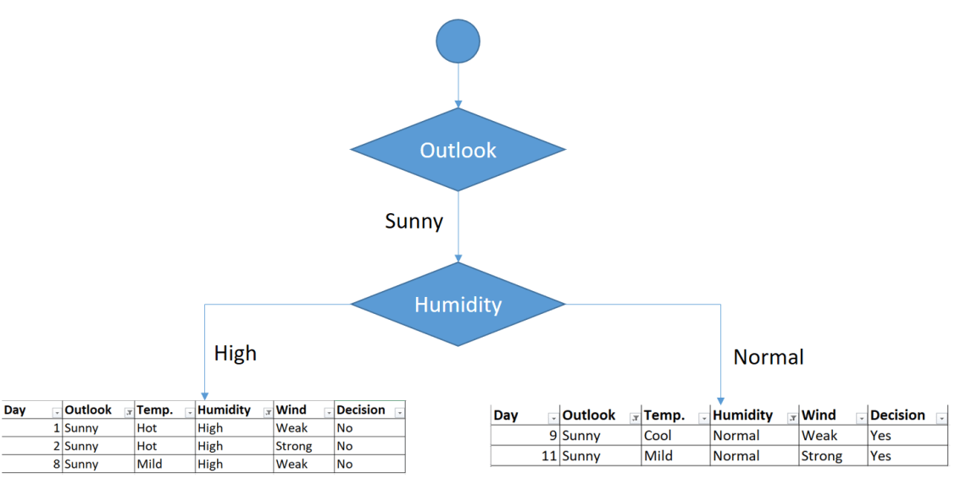
Sub datasets for high and normal humidity
As seen, decision is always no for high humidity and sunny outlook. On the other hand, decision will always be yes for normal humidity and sunny outlook. This branch is over

Slide 14
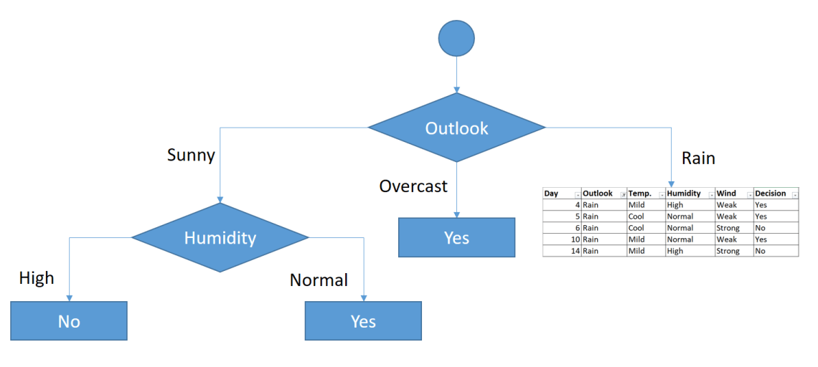
Decisions for high and normal humidity
Now, we need to focus on rain outlook.

Slide 15
Rain outlook
We’ll calculate gini index scores for temperature, humidity and wind features when outlook is rain.
Day | Outlook | Temp. | Humidity | Wind | Decision
4 | Rain | Mild | High | Weak | Yes
5 | Rain | Cool | Normal | Weak | Yes
6 | Rain | Cool | Normal | Strong | No
10 | Rain | Mild | Normal | Weak | Yes
14 | Rain | Mild | High | Strong | No

Slide 16
Gini of temprature for rain outlook
Gini(Outlook=Rain and Temp.=Cool) = 1 – (1/2)² – (1/2)² = 0.5
Gini(Outlook=Rain and Temp.=Mild) = 1 – (2/3)² – (1/3)² = 0.444
Gini(Outlook=Rain and Temp.) = (2/5)x0.5 + (3/5)x0.444 = 0.466
Temperature | Yes | No | Number of instances
Cool | 1 | 1 | 2
Mild | 2 | 1 | 3
Gini of humidity for rain outlook
Gini(Outlook=Rain and Humidity=High) = 1 – (1/2)² – (1/2)² = 0.5
Gini(Outlook=Rain and Humidity=Normal) = 1 – (2/3)² – (1/3)² = 0.444
Gini(Outlook=Rain and Humidity) = (2/5)x0.5 + (3/5)x0.444 = 0.466
Humidity | Yes | No | Number of instances
High | 1 | 1 | 2
Normal | 2 | 1 | 3

Slide 17
Gini of wind for rain outlook
Gini(Outlook=Rain and Wind=Weak) = 1 – (3/3)² – (0/3)² = 0
Gini(Outlook=Rain and Wind=Strong) = 1 – (0/2)² – (2/2)² = 0
Gini(Outlook=Rain and Wind) = (3/5)x0 + (2/5)x0 = 0
Wind | Yes | No | Number of instances
Weak | 3 | 0 | 3
Strong | 0 | 2 | 2
Decision for rain outlook
The winner is wind feature for rain outlook because it has the minimum gini index score in features.
Put the wind feature for rain outlook branch and monitor the new sub data sets.
Feature | Gini index
Temperature | 0.466
Humidity | 0.466
Wind | 0

Slide 18
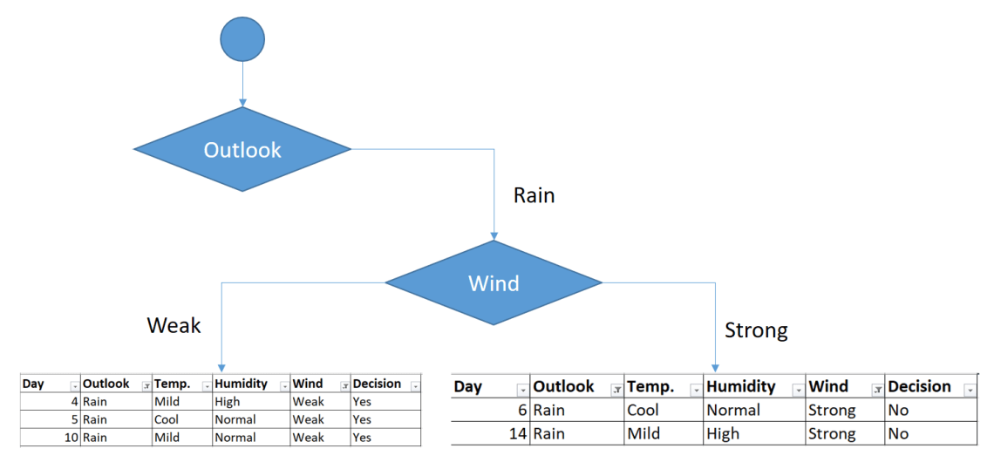
Sub data sets for weak and strong wind and rain outlook
As seen, decision is always yes when wind is weak. On the other hand, decision is always no if wind is strong. This means that this branch is over.

Slide 19
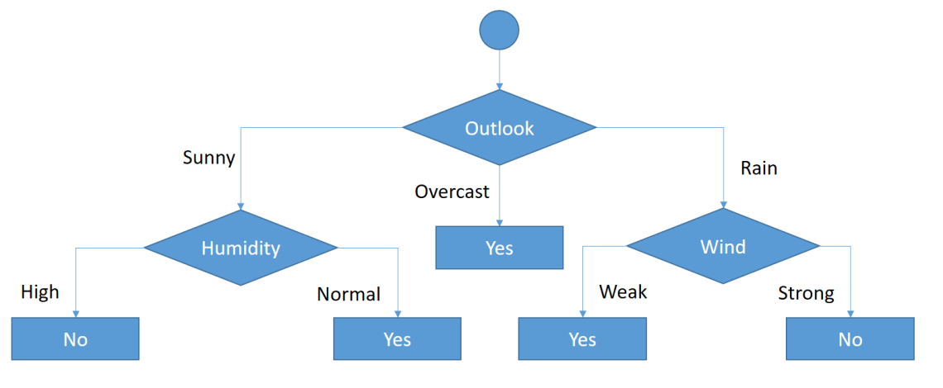
Final form of the decision tree built by CART algorithm
So, decision tree building is over.

